Slide 1
AXI4 Manager Interface
BM component
(SafeTI)
AXI4 Manager
interface
AXI4 Subordinate
interface
AXI4 Network

Slide 2
AXI4 Protocol features
- Every transaction is executed through a burst, where many beats transfers are executed until the completion of the burst.
- The subordinates allocate 4kB of memory (4096 address spaces). This sets the 4kB boundary rule where any burst must not surpass the 4kB address space, since every burst is specific to a subordinate.
- The protocol features 5 channels (group of busses); AW, AR, W, R and B.
- The read and write data busses are extensible from 8 upto 1024 bits in power of two’s steps. The width of the data bus fixes what addresses each byte lane can access. For instance, 64 and 128 bus width:
Addresses ended in 0xXX &
7/F | 6/E | 5/D | 4/C | 3/B | 2/A | 1/9 | 0/8
F | E | D | C | B | A | 9 | 8 | 7 | 6 | 5 | 4 | 3 | 2 | 1 | 0

Slide 3
AXI4 Bus use
Handshake Beats Response
Use AX* channel: Read transactions: Read transactions:
M -> S M -> S, R channel: S -> M, R channel:
> Burst mode. > Ready data. > Burst response.
> Starting address. S -> M, R signals:
> Size mode. > Read data. Write transactions:
> Burst length. > Valid data. S -> M, B channel:
> Valid control. > Last beat. > Beat response.
- ID. Write transactions:
- Memory region. M -> S, W channel:
- Lock. > Write data. S: Subordinate.
- Cache. > Valid data. M: Manager.
- Protected. > Last beat.
- QOL. - Write strobe. *: X is W for write
S -> M S -> W, W channel: and R for read
> Control ready. > Ready data. transactions.

Slide 4
AXI4 Manager interface structure for Handshake
4kB address
boundary check
Decide length +
Starting address
I/O Registration
Decide size mode
I/O Registration
RD request
RD grant
AR valid
AR ready
BM
Component
AXI4
BRAM
Subordinate
WR request
WR grant
AW valid
AW ready
4kB address
boundary check
Decide length +
Starting address
I/O Registration
Decide size mode
I/O Registration

Slide 5
AXI4 Manager interface structure for data transfer
FIFO
I/O Registration
I/O Registration
BM mask
AXI mask
RD valid
R ready
R valid
BM
Component
AXI4
BRAM
Subordinate
Shifter
FIFO
W valid
W ready
WR data
WR ready
AXI strobe
I/O Registration
I/O Registration
Shifter

Slide 6
AXI4 Transaction example
BM read transaction request:
Starting address = 0x0FFB
Total size transfer = 23 bytes
(codification) = 0x16
Let’s suppose a BM data bus width of 32 bits
(dbits) and an AXI data bus width of 128 bits
(AXI4_DATA_WIDTH).

Slide 7
AXI4 Transaction example
BM read transaction request:
Starting address = 0x0FFB
Total size transfer = 23 bytes
(codification) = 0x16
Let’s suppose a BM data bus width of 32 bits
(dbits) and an AXI data bus width of 128 bits
(AXI4_DATA_WIDTH).
0x0FFB + 23 data bytes – 1 = 0x1011 <- Last read address to BM transfer.
^---------------------------------------^- Acces to two different subordinates is required.

Slide 8
AXI4 Transaction example
BM read transaction request:
Starting address = 0x0FFB
Total size transfer = 23 bytes
(codification) = 0x16
Let’s suppose a BM data bus width of 32 bits
(dbits) and an AXI data bus width of 128 bits
(AXI4_DATA_WIDTH).
0x0FFB + 23 data bytes – 1 = 0x1011 <- Last read address to BM transfer.
^---------------------------------------^- Acces to two different subordinates is required.
First burst:
0x0FFF – 0x0FFB = 5 data bytes -> Size mode is 8 bytes/beat.
Only one beat is required with a starting address of 0x0FF0.
Second burst:
23 data bytes – 5 data bytes = 18 data bytes -> Size mode is 16 bytes/beat.
(Size mode limited by AXI4_DATA_WIDTH)
Two beats are required with a starting address of 0x1000.

Slide 9
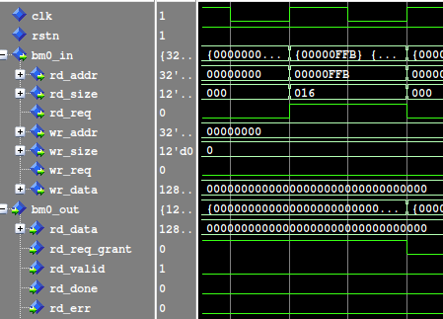
AXI4 Transaction example
BM read transaction request:
Starting address = 0x0FFB
Total size transfer = 23 bytes
(codification) = 0x16
Since the 4kB boundary space is
expected to be surpassed by the request, two AXI bursts are generated.
First AXI burst:
Starting address = 0x0FF8
Size mode = 8 bytes = 011’b
Burst length = 1 beat = 0x00
Second AXI burst:
Starting address = 0x1000
Size mode = 16 bytes = 100’b
Burst length = 2 beats = 0x01

Slide 10
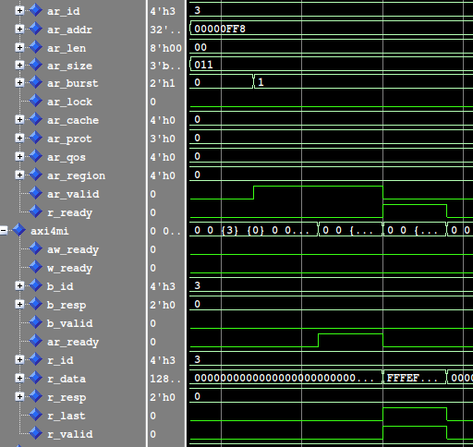
AXI4 Transaction example
BM read transaction request:
Starting address = 0x0FFB
Total size transfer = 23 bytes
(codification) = 0x16
Since the 4kB boundary space is
expected to be surpassed by the request, two AXI bursts are generated.
First AXI burst:
Starting address = 0x0FF8
Size mode = 8 bytes = 011’b
Burst length = 1 beat = 0x00
Second AXI burst:
Starting address = 0x1000
Size mode = 16 bytes = 100’b
Burst length = 2 beats = 0x01

Slide 11
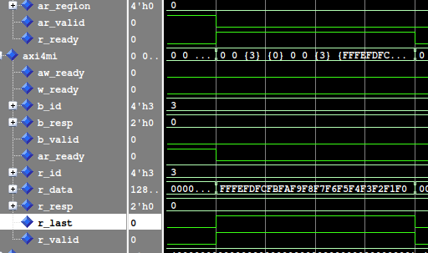

AXI4 Transaction example
BM read transaction request:
Starting address = 0x0FFB
Total size transfer = 23 bytes
(codification) = 0x16
Since the 4kB boundary space is
expected to be surpassed by the request, two AXI bursts are generated.
First AXI burst:
Starting address = 0x0FF8
Size mode = 8 bytes = 011’b
Burst length = 1 beat = 0x00
Second AXI burst:
Starting address = 0x1000
Size mode = 16 bytes = 100’b
Burst length = 2 beats = 0x01

Slide 12
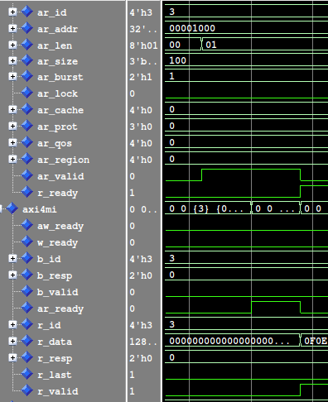
AXI4 Transaction example
BM read transaction request:
Starting address = 0x0FFB
Total size transfer = 23 bytes
(codification) = 0x16
Since the 4kB boundary space is
expected to be surpassed by the request, two AXI bursts are generated.
First AXI burst:
Starting address = 0x0FF8
Size mode = 8 bytes = 011’b
Burst length = 1 beat = 0x00
Second AXI burst:
Starting address = 0x1000
Size mode = 16 bytes = 100’b
Burst length = 2 beats = 0x01

Slide 13
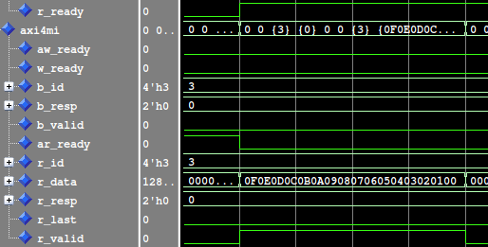
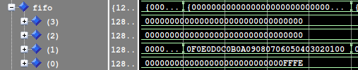
AXI4 Transaction example
BM read transaction request:
Starting address = 0x0FFB
Total size transfer = 23 bytes
(codification) = 0x16
Since the 4kB boundary space is
expected to be surpassed by the request, two AXI bursts are generated.
First AXI burst:
Starting address = 0x0FF8
Size mode = 8 bytes = 011’b
Burst length = 1 beat = 0x00
Second AXI burst:
Starting address = 0x1000
Size mode = 16 bytes = 100’b
Burst length = 2 beats = 0x01

Slide 14
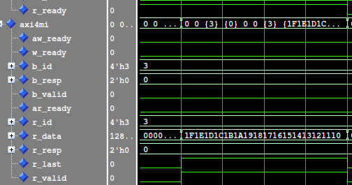
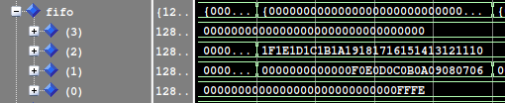
AXI4 Transaction example
BM read transaction request:
Starting address = 0x0FFB
Total size transfer = 23 bytes
(codification) = 0x16
Since the 4kB boundary space is
expected to be surpassed by the request, two AXI bursts are generated.
First AXI burst:
Starting address = 0x0FF8
Size mode = 8 bytes = 011’b
Burst length = 1 beat = 0x00
Second AXI burst:
Starting address = 0x1000
Size mode = 16 bytes = 100’b
Burst length = 2 beats = 0x01

Slide 15
AXI4_DATA_WIDTH
dbits
BM read transaction request:
Starting address = 0x0FFB
Total size transfer = 23 bytes
(codification) = 0x16
Since the 4kB boundary space is
expected to be surpassed by the request, two AXI bursts are generated.
First AXI burst:
Starting address = 0x0FF0
Size mode = 8 bytes = 011’b
Burst length = 1 beat = 0x00
Second AXI burst:
Starting address = 0x1000
Size mode = 16 bytes = 100’b
Burst length = 2 beats = 0x01
127 96 64 32 0 31 0
: AXI read data, but it’s unrequested by BM. : BM requested data from first, second and third beats.
(*): Skipped time slots. Represented to better conceptualize the state of the different FIFO regs with the dbits slot.

Slide 16
AXI4_DATA_WIDTH
dbits
BM control
valid
done
BM read transaction request:
Starting address = 0x0FFB
Total size transfer = 23 bytes
(codification) = 0x16
Since the 4kB boundary space is
expected to be surpassed by the request, two AXI bursts are generated.
First AXI burst:
Starting address = 0x0FF8
Size mode = 8 bytes = 011’b
Burst length = 1 beat = 0x00
Second AXI burst:
Starting address = 0x1000
Size mode = 16 bytes = 100’b
Burst length = 2 beats = 0x01
127 96 64 32 0 31 0
t(0) t(1)
(*)
0 0
1 0
fifo(0)
: AXI read data, but it’s unrequested by BM. : BM requested data from first, second and third beats.
(*): Skipped time slots. Represented to better conceptualize the state of the different FIFO regs with the dbits slot.

Slide 17
AXI4_DATA_WIDTH
dbits
BM control
valid
done
BM read transaction request:
Starting address = 0x0FFB
Total size transfer = 23 bytes
(codification) = 0x16
Since the 4kB boundary space is
expected to be surpassed by the request, two AXI bursts are generated.
First AXI burst:
Starting address = 0x0FF8
Size mode = 8 bytes = 011’b
Burst length = 1 beat = 0x00
Second AXI burst:
Starting address = 0x1000
Size mode = 16 bytes = 100’b
Burst length = 2 beats = 0x01
127 96 64 32 0 31 0
t(0) t(1)
(*)
(*)
t(2)
t(3)
t(4)
t(5)
(*)
(*)
t(6)
0 0
1 0
fifo(0)
1 0
1 0
1 0
1 0
fifo(1)
fifo(2)
1 1
: AXI read data, but it’s unrequested by BM. : BM requested data from first, second and third beats.
(*): Skipped time slots. Represented to better conceptualize the state of the different FIFO regs with the dbits slot.

Slide 18
AXI4_DATA_WIDTH
dbits
BM control
valid
done
127 96 64 32 0 31 0
t(0) t(1)
(*)
(*)
t(2)
t(3)
t(4)
t(5)
(*)
(*)
t(6)
0 0
1 0
fifo(0)
1 0
1 0
1 0
1 0
fifo(1)
fifo(2)
1 1
: AXI read data, but it’s unrequested by BM. : BM requested data from first, second and third beats.
(*): Skipped time slots. Represented to better conceptualize the state of the different FIFO regs with the dbits slot.

Slide 19
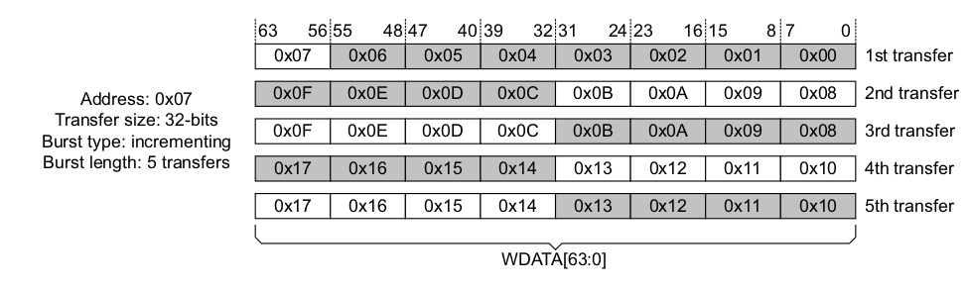
AXI4 Narrow transfer example
Source: “Figure A3-14 Aligned and unaligned transfers on a 64-bit bus”, page A3-58, from ARM IHI 0022H.c
"AMBA AXI and ACE Protocol Specification”.

Slide 20
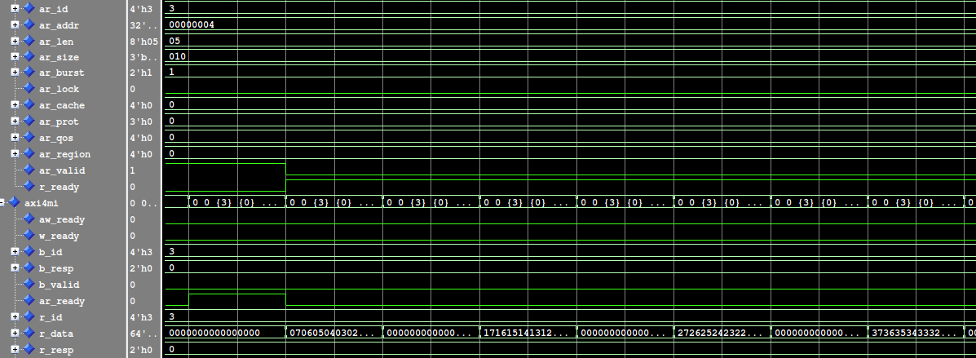
AXI4 Narrow transfer example on faulty subordinate
Hand- 1st beat 2nd beat 3rd beat 4th beat
shake

Slide 21
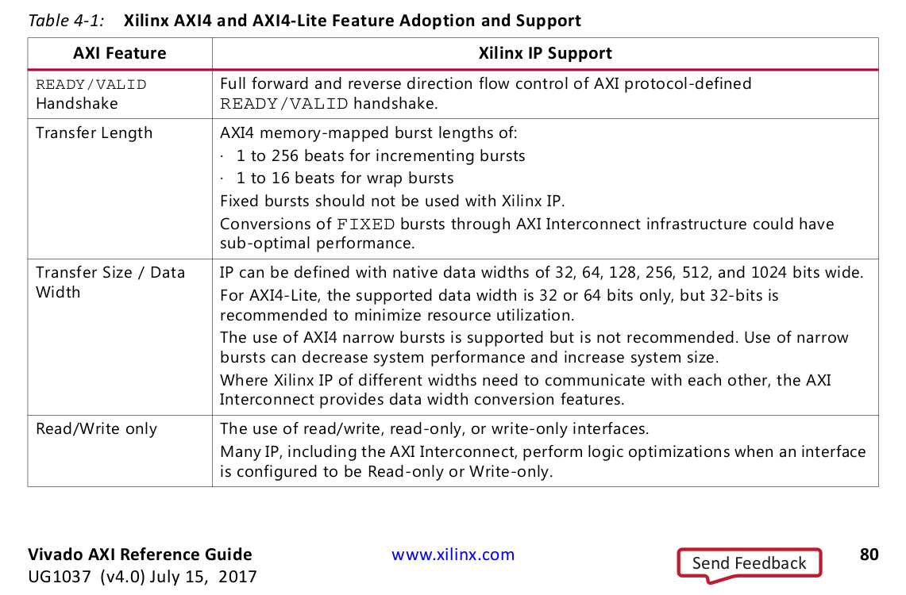

Slide 22
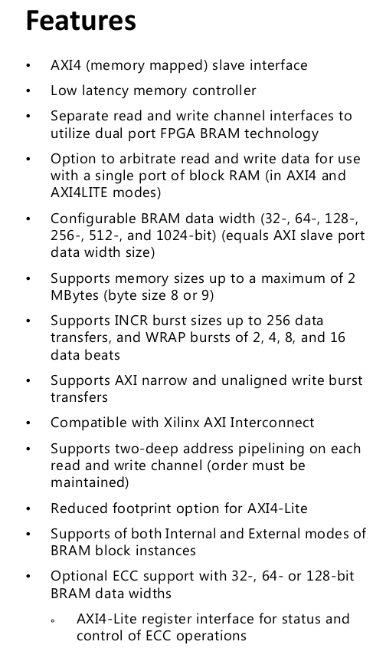
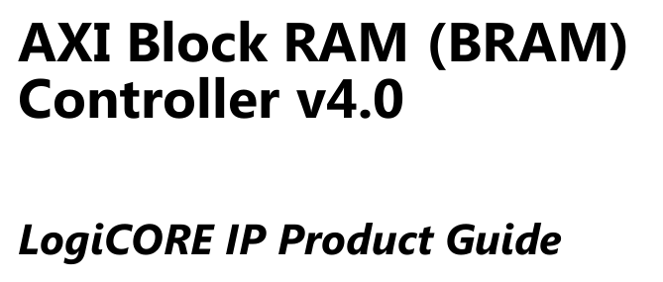

Slide 23
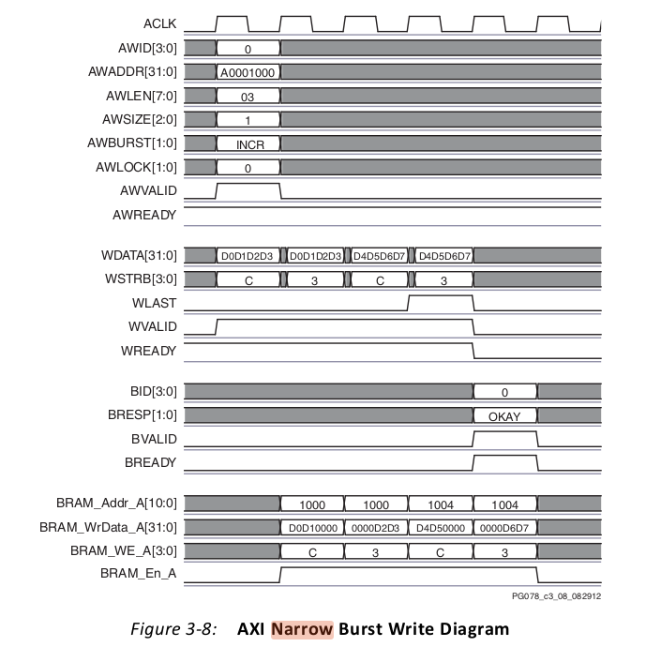

Slide 24
Conclusions
- Started the design of the interface executing narrow bursts always. But, due to the characteristics of the subordinate used for debugging, the interface has been modified to only execute narrow bursts if they occur in different AXI4_DATA_WIDTH addresses (more efficient).
- The modifications have made the interface to be incapable of managing multiple narrow bursts that occur on the same AXI4_DATA_WIDTH slot. However, it also has given a step to simplify the interface logic, that it could be simplified even further. This would be by setting an AXI size mode adjusted to AXI4_DATA_WIDTH, saving resources and even a clock cycle.
- At the moment, the AXI4 Manager interface only executes incremental bursts.

